Slide 1

IISR P2GN1
Sync — nothing important missed
Problem statement PR 007 · General

Slide 2

Introduction
Sync is a private copilot for the conversations that matter.
It sits on your side of every call and meeting. It listens on your own laptop, quietly points out what's being missed while you can still act, and remembers every project, so nothing that was said is ever lost.
01 Listens with you
Joins your calls automatically: Phone Link, Zoom, Teams, Meet and WhatsApp. Skip any call with one key.
02 Nudges in the moment
One short, private hint on your screen when a question goes unasked or a detail doesn't add up.
03 Remembers by project
Every fact, number, decision and promise lands in the right project, ready for your next call.
Made for anyone whose conversations matter: sales calls, support, negotiations, client meetings and team discussions.
“Sync doesn't help you talk. It helps you finish.”

Slide 3
Problem Statement
“People often have to listen, think and respond at the same time, causing important points and decisions to be missed.”
Problem statement PR 007
01 Too much to hold at once
While you listen and reply, the question you meant to ask slips away. The costliest failures are omissions, not mistakes.
02 Context is scattered
One deal or project runs over many calls and people. Notes live in five places, so people re-ask, contradict each other and forget what was agreed.
03 Problems surface too late
A missing owner or a vague date only shows up days later, when the deal stalls or the customer calls back.
What usually gets missed
The question nobody asked
The condition attached to an offer
A decision with no owner
“We said the 15th” vs “the 22nd”
A promise nobody wrote down

Slide 4
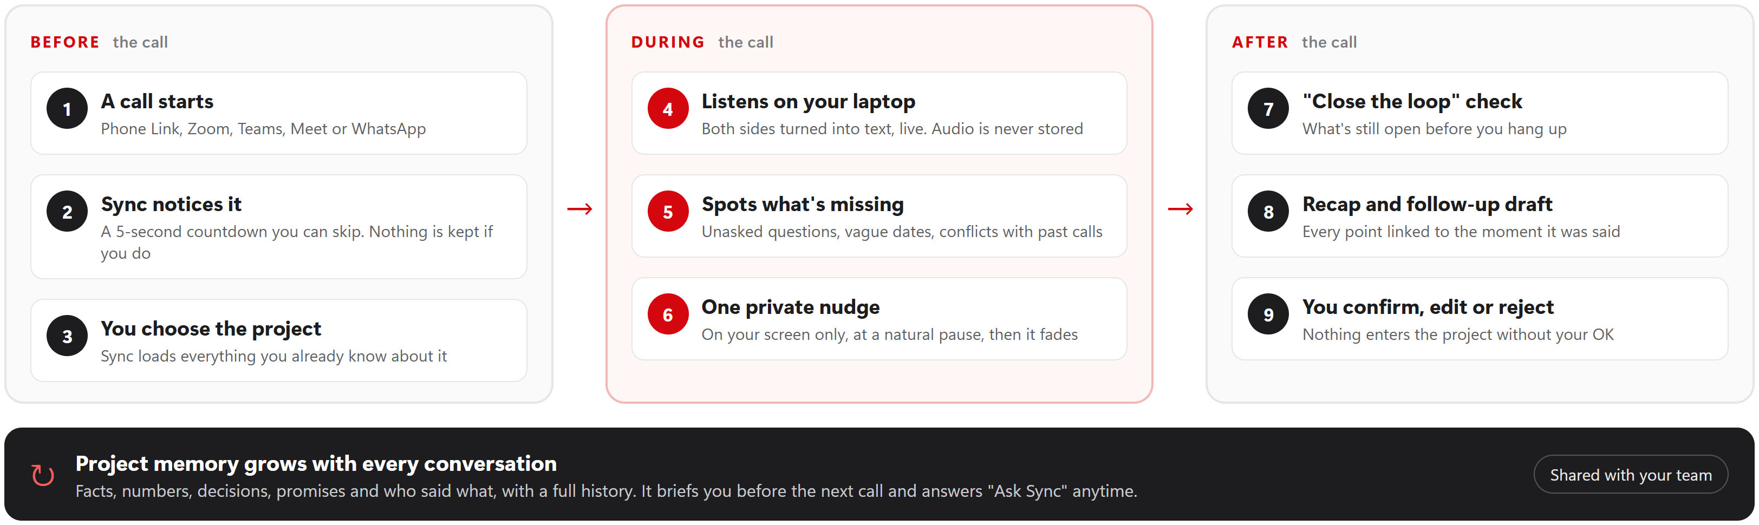
Proposed Solution
Sync works quietly before, during and after every call, and only you can see it.
Private by default
Runs fully on your laptop. Audio is never stored and nobody else on the call is notified.
You stay in control
Skip any call, choose the project, and confirm every update before it's saved.
Useful from the first call
No setup or training needed. Each conversation makes the next one sharper.

Slide 5
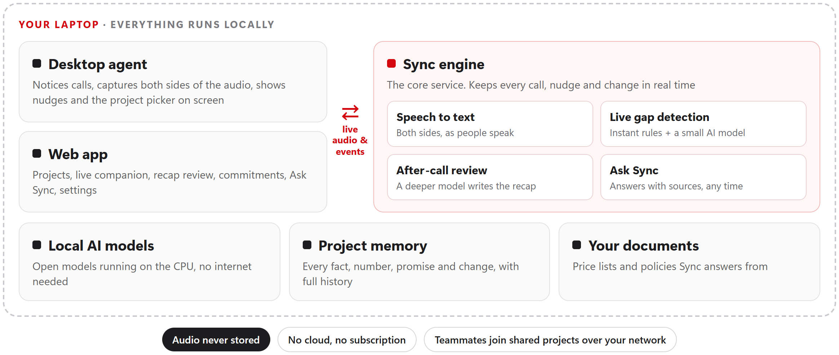
Technical Architecture and Tech Stack
Everything runs on one ordinary laptop: no cloud, no GPU, no subscription.
Main tech stack
Python + FastAPI
The core service and its live connections
Ollama with open AI models
Granite 4.1 (3B) during calls, Qwen3 (4B) after them
NVIDIA Parakeet
On-device speech recognition
SQLite + embeddings
Project memory and smart search
HTML · CSS · JavaScript
The web app, plus a light on-screen nudge strip
100% free and open source
How a nudge happens
speech becomes text as people talk → instant checks against the project's memory → a small local model weighs the subtle cases → one nudge appears at a natural pause.

Slide 6
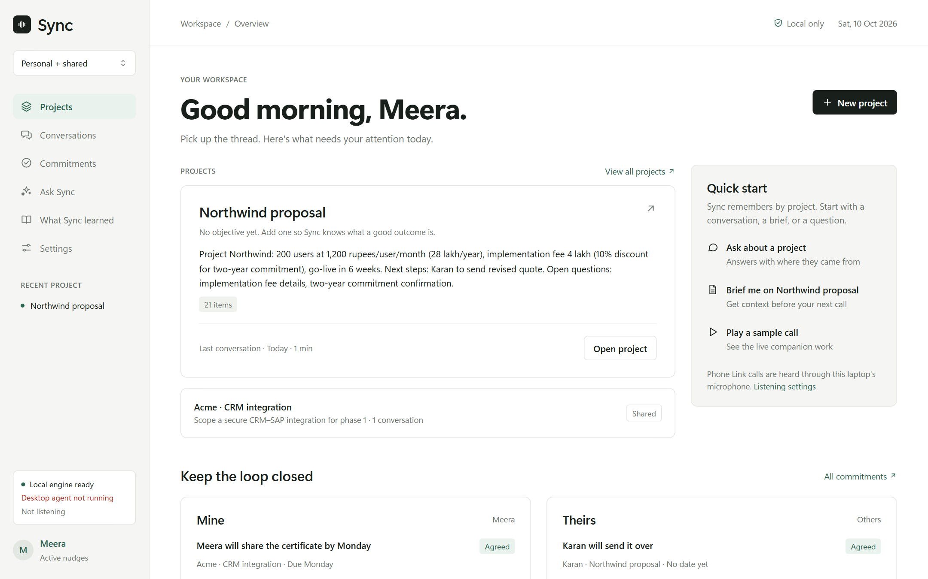
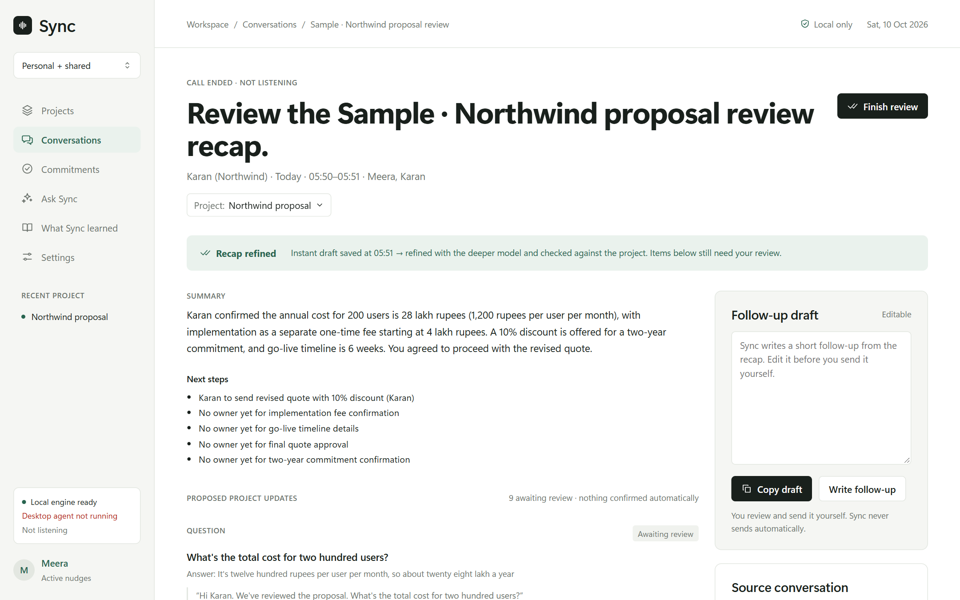
User Experience and Usability
Designed to stay out of the way: calm, private and always under your control.
Workspace: projects, open commitments and recent calls at a glance
After the call: review the recap, confirm what goes into the project
One nudge at a time Short, on screen, at a natural pause. It fades on its own.
Only you see it No bot joins the call. Nothing is said out loud.
You're in control Auto, Ask or Off. Skip with Ctrl+Alt+S. Per-app rules.
Every point has a source Click any item to see exactly who said it and when.
Zero setup Helpful from the first call. Projects build themselves.
Calm, simple design A clean light theme that matches the on-screen nudges.

Slide 7
Key Features and Implementation
What Sync does, and how it does it.
Auto-listen with an off switch
Notices a call the moment an app uses your microphone, then gives you 5 seconds to skip.
How: watches which app holds the mic (never the audio), with per-app and per-contact rules.
Live gap detection
Catches unanswered questions, vague dates, unconfirmed conditions, tasks with no owner and contradictions.
How: 16 kinds of gaps, checked instantly by rules plus a small local AI model.
Answers from your documents
Price lists and policies answered on screen, even quick sums like 15 × ₹1,200 × 6/12 = ₹9,000.
How: local semantic search over your files and past calls.
Project memory with history
Every fact, number, decision and promise, linked to the moment it was said.
How: an append-only record. Every change shows who made it and when.
A recap you approve
After the call, a deeper model re-reads it and proposes updates and a follow-up draft.
How: nothing is saved to the project until you confirm, edit or reject it.
Ask Sync and shared projects
Ask anything about past calls and get answers with sources. Invite teammates to a project.
How: chat over the project's full memory. Teammates join with an invite link.

Slide 8
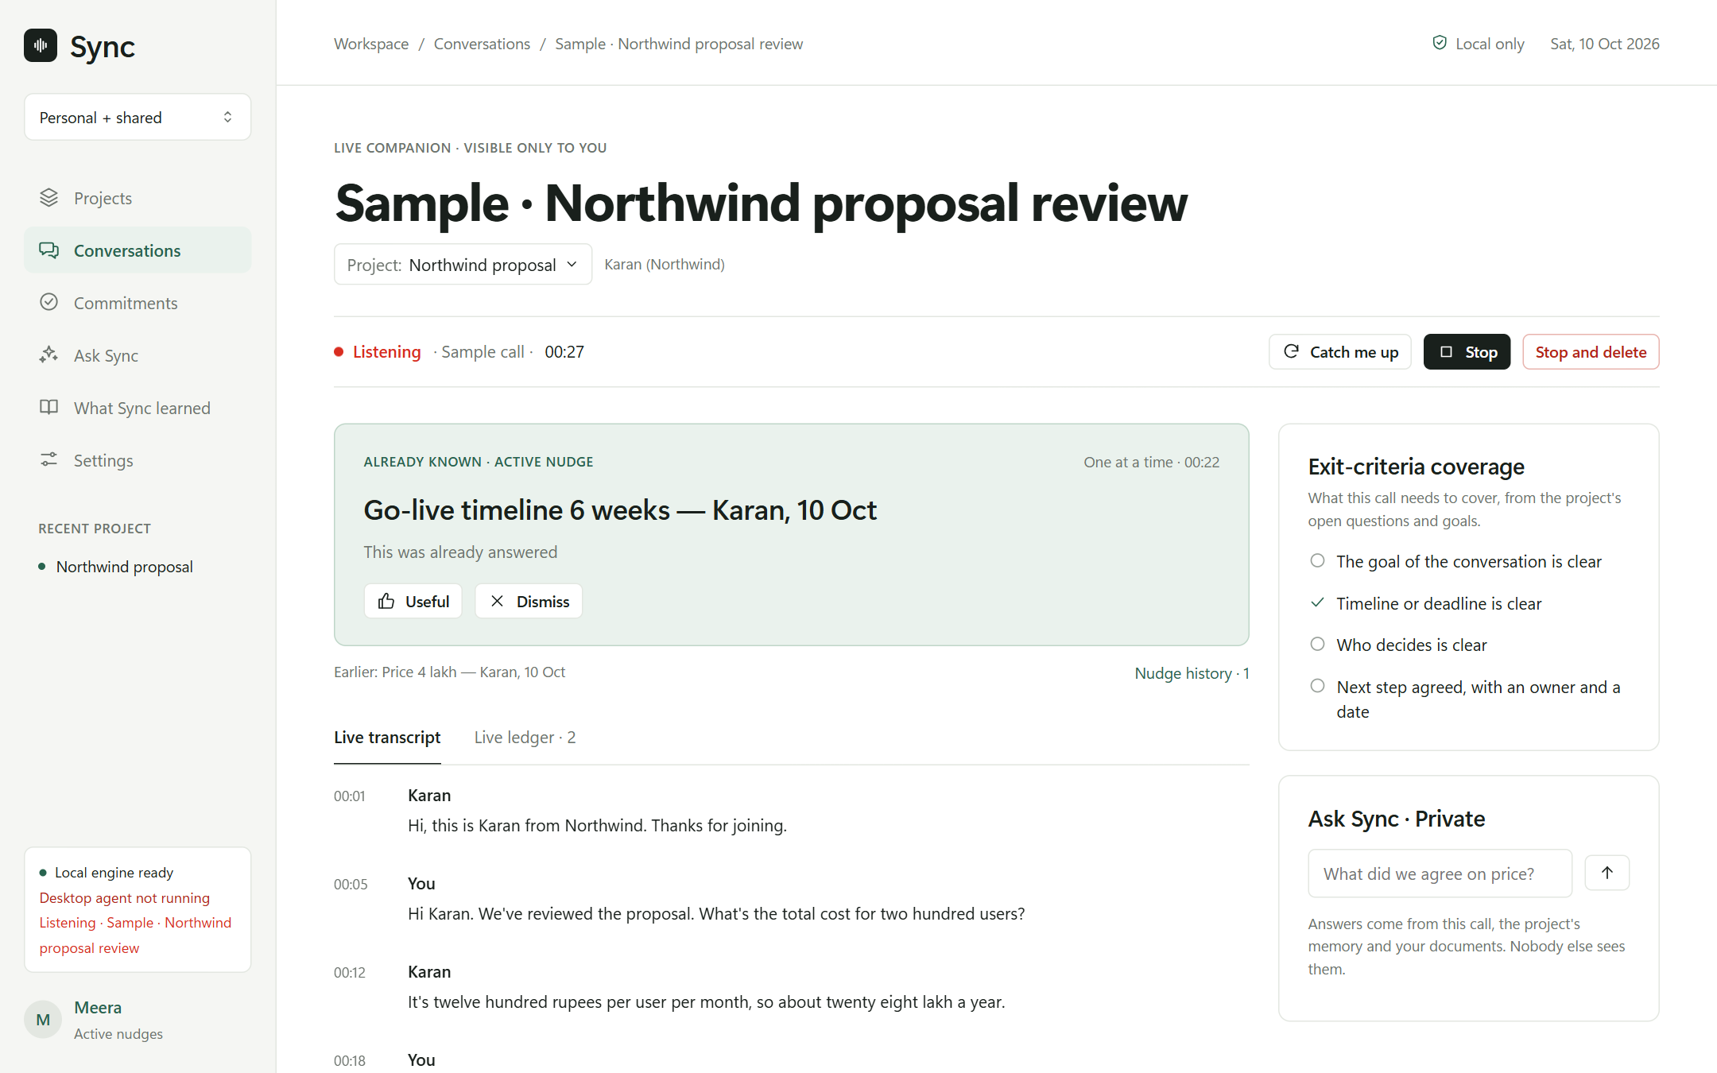
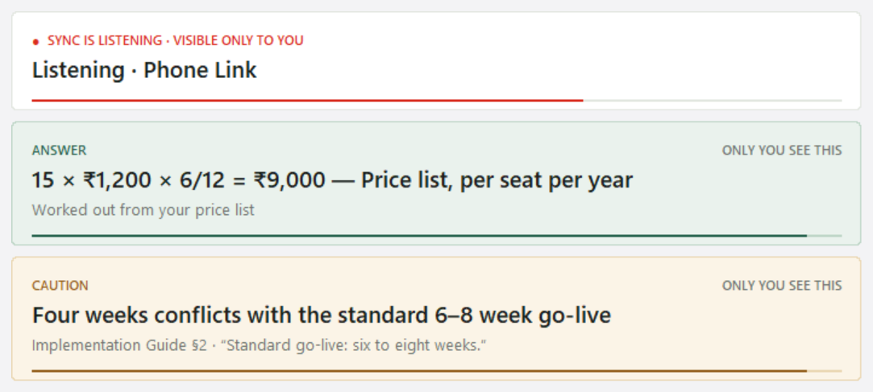
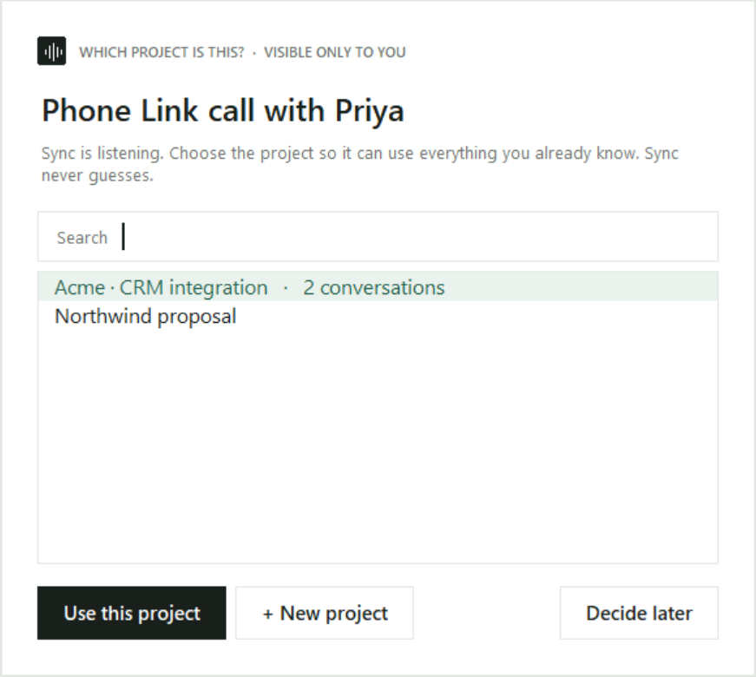
Live Demo with UI
Demo: a real (sample) call running through Sync, live on this laptop.
On-screen nudges, over any app, visible only to you
Demo flow
1. Play a sample call
2. Sync spots it and asks which project
3. Nudges appear as the call goes
4. “Close the loop” before hanging up
5. Review the recap and follow-up
Live companion: the active nudge, live transcript and goals still to cover

Slide 9
Impact, Feasibility and Scalability
13 / 13
planted moments caught in our test scripts
0
wrong nudges in those tests
₹0
running cost: free and open source
100%
on your laptop: audio never stored
Impact
Fewer missed questions, owners and dates, caught while you can still act.
Clients aren't asked the same thing twice: everyone works from one record.
Tested on 4 scripted scenarios, including a group discussion.
Feasibility
Runs on an ordinary CPU laptop (i7, 16 GB). No GPU, no cloud.
Built entirely on free, open-source tools and open AI models.
Private by design, so it's easy to trust at work.
Scalability
Shared projects for teams today, over your local network.
Bigger models drop in when a GPU is available, with no code changes.
Next: mobile companion, more languages, calendar and CRM links.

Slide 10
Conclusion
Sync doesn't help you talk.
It helps you finish.
01 Catches what's missed
while there's still time to fix it, without interrupting the conversation.
02 Remembers every project
so nobody re-asks, contradicts or forgets what was agreed.
03 Private, local and free
it works for you, on your own laptop, and never keeps your audio.
What's next: pilots with real teams · a mobile companion · more languages · calendar and CRM connectors
Thank you

